Slide 1
CS 4530: Fundamentals of Software Engineering Module 1.1 Course Introduction
Jon Bell, Adeel Bhutta and Mitch Wand
Khoury College of Computer Sciences
© 2024 Released under the CC BY-SA license

Slide 2
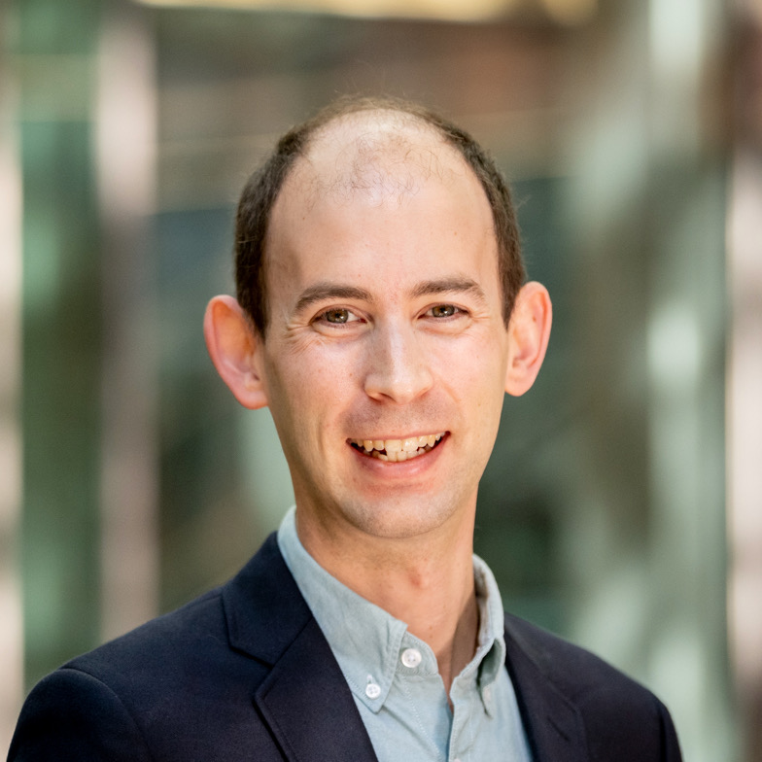
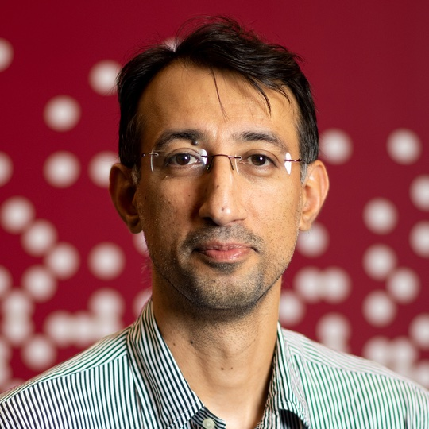
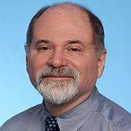
Instructors
Jonathan Bell
Section 1
Adeel Bhutta
Section 2, 3 & 5
Mitch Wand
Section 4

Slide 3
Teaching Assistants
We have around 250 students and 15 teaching assistants.
Their contact info and pictures are on the website
https://neu-se.github.io/CS4530-Spring-2024/staff/

Slide 4
Learning Objectives for this Lesson
By the end of this lesson, you should be able to:
Explain in general terms what software engineering is
List your weekly obligations as a student
List the requirements for completing the course

Slide 5
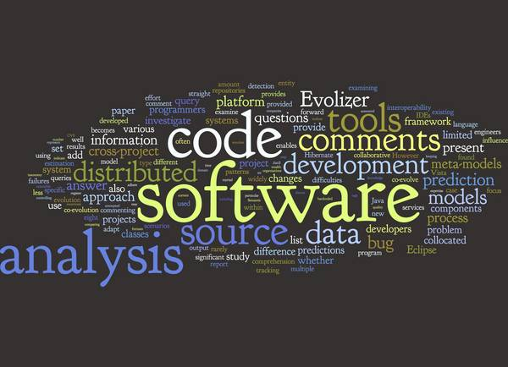
What is software engineering?
Software Engineering refers to the tools and processes that we use to
design,
construct, and
maintain programs
over time.
tools
5
methods
process model
Applying “engineering” to Software!
a “quality” focus
Notes:
Software engineering refers to study of all aspects of software development …. It is an attempt to apply a typical engineering “process” to building of software. The word cloud shows everything that’s typically part of SE. We will highlight the approaches that {hopefully} scale well.

Slide 6
Software Engineering encompasses the entire software development life cycle
Write/Refine Requirements
Create Tests
Code
Debug or Redesign until Tests Pass
Deploy/Collect Feedback
Design
Notes:
We will look over all aspects of SDLC and our focus will be on TDD. There are several different SDLCs that have been proposed over the last half a century.

Slide 7
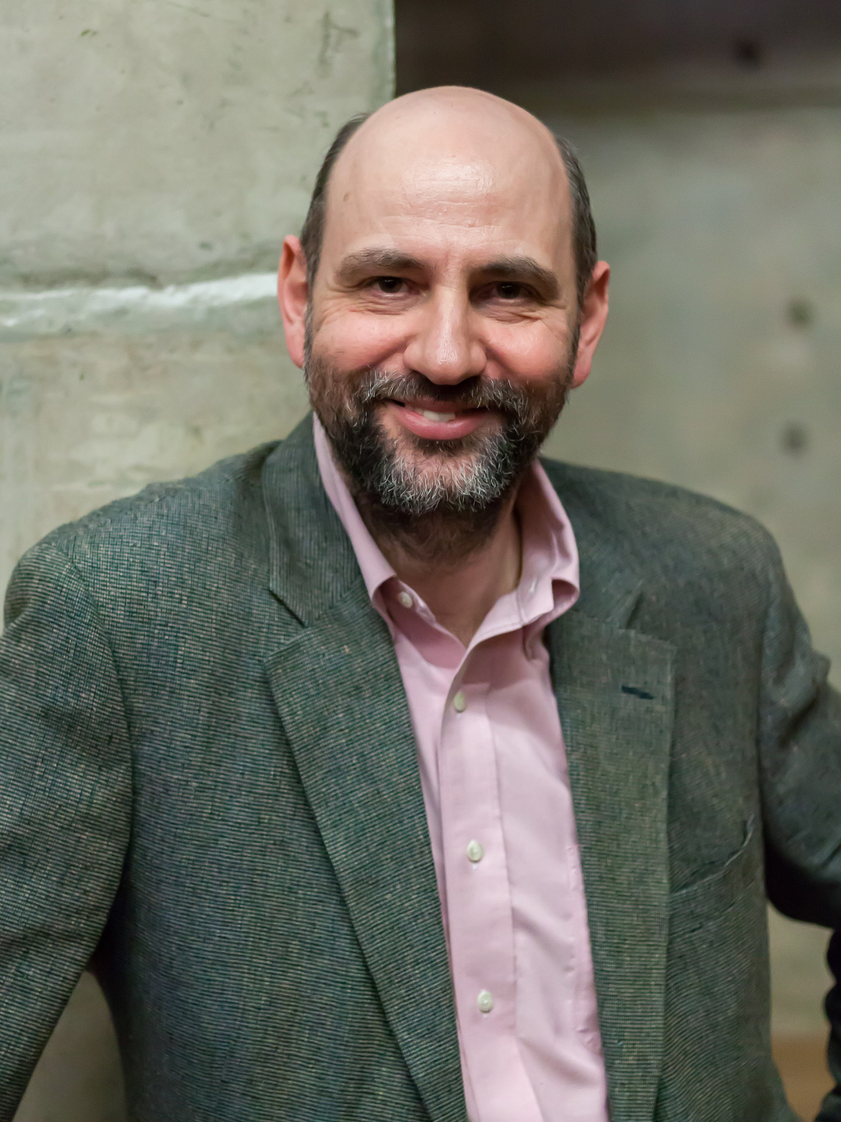
Software Engineering is about People
“Any fool can write code that a computer can understand. Good programmers write code that humans can understand”
- Martin Fowler

Slide 8
But this raises many questions
How {big} is each cycle? When do you repeat it?
In terms of code to be written?
In terms of time?
In terms of person-power?
Can you have multiple cycles going at once?
What artifacts need to be produced at the end of each stage?
Need to prepare for the next time through the cycle.
Need to document what was done, so that others can build on your work.
Notes:
How are they different? Which one should you use? The answer is: it depends ….

Slide 9
The answers depend on many factors
Depends on things like:
the size of the team (i.e., people)
the size of the product
The type of the project
the longevity of the product
There's no one "right" way; no universal process or silver bullet; there are always tradeoffs.
But there are best practices, which we will expect you to follow.
Notes:
Notice 3 Ps of project management

Slide 10
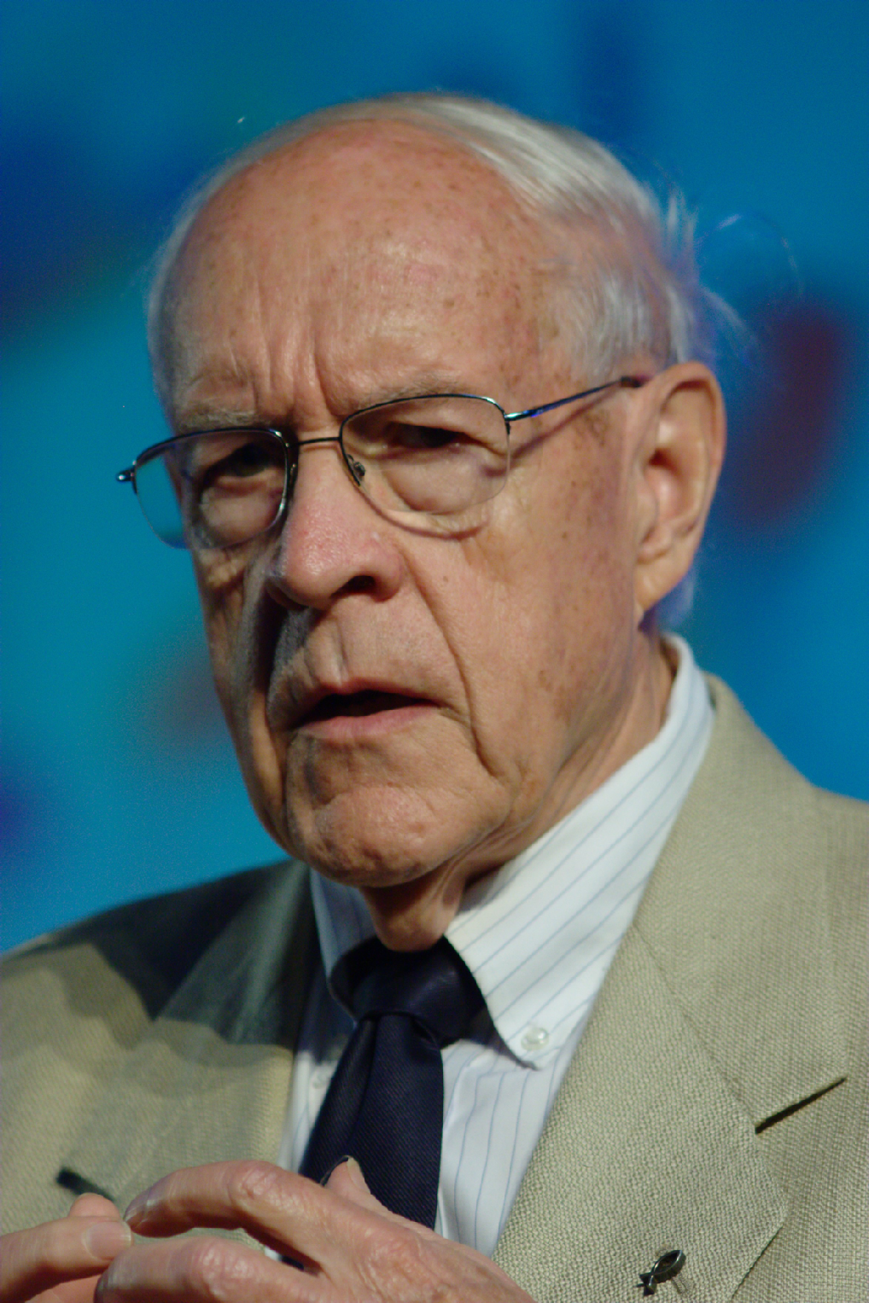
Teams are hard: Brooks’ Law
Mitch added 2/24
“Adding manpower to a late software project makes it later”
Fred Brooks, 1975
Notes:
In the 70’s, a prominent software engineer named Fred Brooks analyzed software construction failures, coining Brooks’ Law: “Adding manpower to a late software project makes it later.” He talked a lot about the problems that software engineers faced at the time.
The core thesis behind his book “The mythical man month” is that it’s a myth to estimate software construction in terms of person-months. This is because complex projects can never be perfectly partitioned into discrete chunks that can be worked on independently.
Hence, when adding more team members, you also increase the amount of communication necessary across team members, making your overall development speed slower, not faster.
If you’ve been following along in the Software Engineering @ Google book this semester, you have likely found that one of the recurring themes in THAT book is to design processes that scale sub-linearly with the size of your team or the scale of your software: that is, to get around Brooks’ law.

Slide 11
Questions for SE to address
Mitch added 2/24
How do you structure teams effectively?
How do you encourage team members to treat each other well?
How do you encourage teams to share knowledge and collaborate?
How do you respond to failures?
How do you respond to changing requirements?
Notes:
[Ask students to share experiences good and bad of working in teams before doing animation]
(Read slide of common team issues)
Our goal with this lesson is to share some common strategies to address these problems. Some of these lessons will be things that you can operationalize: how to be a better team player. Others will be things that you won’t be able to operationalize directly. We do not expect many of you will graduate and immediately enter positions where you will be making decisions about how to structure and lead a team. But, it is quite likely that you will be subject to someone else making those decisions. Through this lesson, we hope to provide you with a framework for understanding how effective teams are organized. One of the core agile principles that we’ve been talking about this week is: how to connect what we are doing to the ultimate value that we are delivering to our customers through our software. By understanding why team processes are setup like they are, hopefully you can understand better the value that those processes provide – and maybe you can even help your manager reflect on and improve their existing processes.

Slide 12
Learning Objectives for this course:
By the end of this course, you will--
Be able to define and describe the phases of the software engineering lifecycle.
Be able to explain the role of key processes and technologies in modern software development.
Be able to productively apply instances of major tools used in elementary SE tasks.
Design and implement a portfolio-worthy software engineering project in a small team environment that can be showcased to recruiters.

Slide 13
Approach
The course will mirror the steps of the software engineering life cycle
starting with requirements, through testing and deployment
Essentially you will be working on a team project that combines all aspects of SE.
We will move some material forward to make sure that you have the learning you need when you need it

Slide 14
Course Mechanics
Our goal is to provide a productive learning environment to both remote and on-the-ground students
100% attendance is expected for both on-the-ground and remote sections
Classes will include both lectures and in-class activities.
Be sure to bring your laptop
Weekly slides will be posted in advance, so be prepared to ask and answer questions about the material.

Slide 15
Course Mechanics: In-Class Exercises and Tutorials
There will often be in-class exercises to give you practice with the technologies we will use.
Typically, will consist of structured steps that will guide you through a typical task
Each instructor will use individual approach to grade in-class activities.
In addition, there will be tutorials posted on the web.
These will extend the in-class materials.

Slide 16
Course Requirements
We will start with an individual project, divided into 2 deliverables. This is to be done individually
Then a group project, done in teams of about 4 people
There will be an exam on Mar 11-13 (Week 10 – Week after Spring break). There will not be a final exam.
The overall grading breakdown is:
30% Individual Assignments (Individual Projects 1 and 2)
40% Team Project
10% Participation & In-class activities
20% Week 10 Exam
Notes:
* Exam is on the first lecture after spring break

Slide 17
Technology
We will use:
TypeScript as implementation language
Jest as Testing Framework
Visual Studio Code as our IDE
React for webapps
GitHub Projects for Project Management
GitHub Actions / Netlify /Heroku / Render for CI/CD
Also, other miscellaneous tools

Slide 18
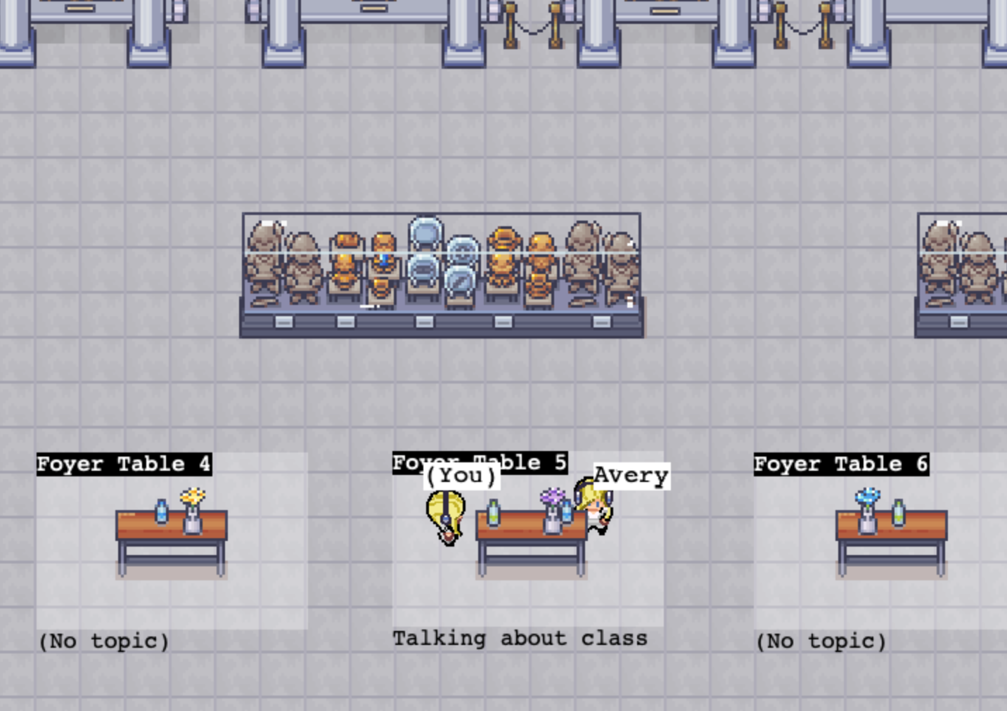
We will use Covey.Town as the running codebase for the course
Covey.Town is a virtual meeting space.
Different groups of people can have simultaneous video calls, allowing participants to drift between different conversations, just like in real life.
Inspired by existing products like Gather.Town, Sococo, and Gatherly.IO
But it is an open-source effort
The features will be proposed and implemented by you!
All implementation will take place in the TypeScript programming language, using React for the user interface.
Notes:
Covey.Town provides a virtual meeting space where different groups of people can have simultaneous video calls, allowing participants to drift between different conversations, just like in real life. Covey.Town is inspired by existing products like Gather.Town , Sococo, and Gatherly.IO— but it is an open source effort, and the features will be proposed and implemented by you! All implementation will take place in the TypeScript programming language, using React for the user interface.

Slide 19
Covey.Town and you
The individual projects will help you become familiar with the codebase.
The team project will be a new feature that you will propose.
Instructors form the teams with your input.
Further breakdown of team project grade (i.e., 40%) is:
Planning (20%)
Process (20%)
Product (40%)
Reports (20%)
Peer evaluations (surveys) may be utilized, and individual contributions WILL impact your project grade (between 0-100%).

Slide 20
Grade Appeal Policy
If you have concerns regarding the grading of your work, please let us know right away.
We provide mechanism for you to request regrades for all work submitted on Autograder (google form)
Do not post on Piazza or email your TA or instructor
All regrade requests must be submitted within 7 days from your receipt of the graded work.
If your regrade request is closed and you feel that the response was not satisfactory, you may appeal to the instructor via email within 48 hours

Slide 21
Late Policy
Your work is late if it is not turned in by the deadline.
10% will be deducted for late HW (individual assignments) turned in within 24 hours after the due date
Individual assignments submitted more than 24 hours late will receive a zero.
If you're worried about being busy around the time of a HW submission, please plan ahead and get started early.
No late submissions allowed for any group work
If you have an accommodation from Disability Resource Center, you must request it from the instructors separately for each assignment or exam.
DRC Accommodations are usually NOT available for Group Assignments (please work with instructor)

Slide 22
Academic Integrity (1)
Students must work individually on all homework assignments.
We encourage you to have high-level discussions with other students in the class about the assignments, however, we require that when you turn in an assignment, it is only your work. That is, copying any part of another student's assignment is strictly prohibited.
If you steal someone else's work, you fail the class.
You are responsible for protecting your work. If someone uses your work, with or without your permission, you fail the class.

Slide 23
Academic Integrity (2)
You are free to reuse small snippets of example code found on the Internet (e.g., via StackOverflow) provided that it is attributed.
Use of co-pilot is permitted
If you are concerned that by reusing and attributing that copied code it may appear that you didn't complete the assignment yourself, then please raise a discussion with the instructor.
If you are in doubt whether using others' work is allowed, you should assume that it is NOT allowed unless the instructors confirm otherwise.

Slide 24
Communication
Canvas
Course web page (https://neu-se.github.io/CS4530-Spring-2024)
Canvas will mirror the course web site.
Assignments, important notices, etc., will appear in both places.
Piazza (see Canvas for link)
for questions about assignments, projects, etc.
Office Hours
Schedule is available at (https://neu-se.github.io/CS4530-Spring-2024/staff/)
TA Office Hours are held via Khoury Office Hours App

Slide 25
Review
Now that you've studied this lesson, you should be able to:
Explain in general terms what software engineering is
List your weekly obligations as a student
List the requirements for completing the course
Notes:
Lesson 1.1 Activity: Introductions Activity 1: Introduce yourself and ask students to introduce themselves
Activity 2 {Optional}: Welcome Survey. Then discuss survey responses and answer questions

